Slide 1
Working with Arrays, Loops, and Selection Statements
Creating a Monthly Calendar
Tutorial 3
New Perspectives on JavaScript, Comprehensive

Slide 2
Objectives
Review problem solving process in preparation for writing more complex JavaScripts
  Describe the steps in the program design process
  Identify the 3 structured programming control structures
  Write and test algorithms written in pseudocode that use sequence, selection and repetition
Tutorial 2
New Perspectives on JavaScript, Comprehensive

Slide 3
Objectives
Review selection in JavaScript
  Work with if statements
  Work with switch statements
Introduce Arrays
  Concept
  Syntax in JavaScript
Introduce loops in JavaScript
  Work with For loops
  Work with While loops
  Loop through the contents of an array
Use arrays, loops, and conditional statements to create a calendar
Tutorial 3
New Perspectives on JavaScript, Comprehensive

Slide 4
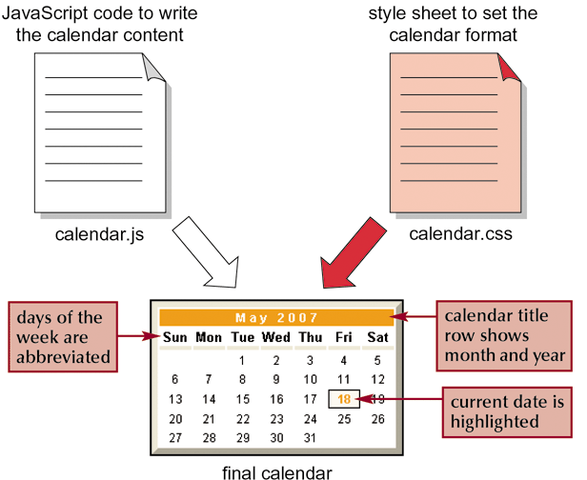
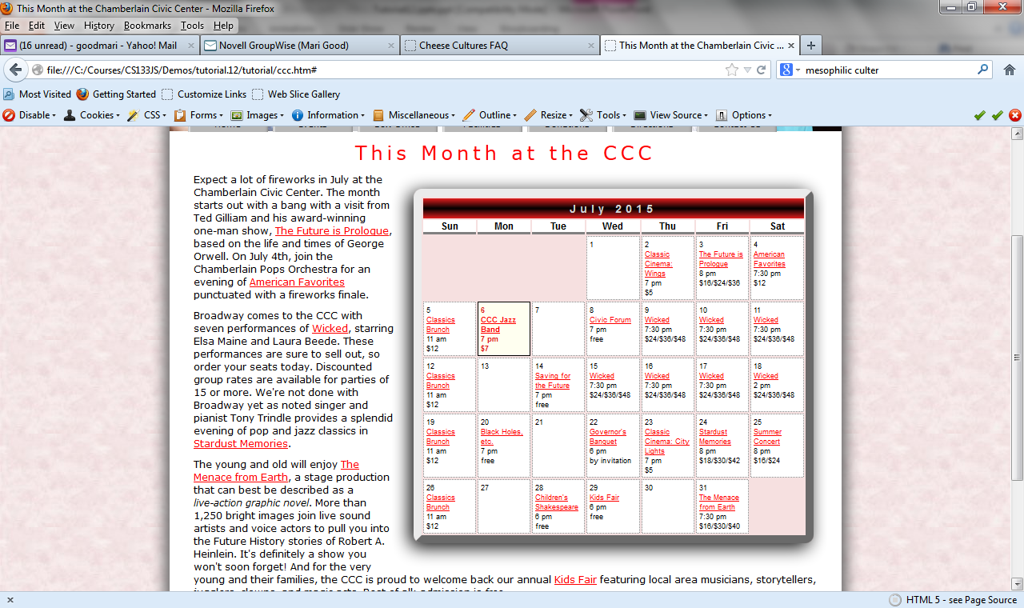
Introducing the Monthly Calendar
days of the week
New Perspectives on JavaScript, Comprehensive

Slide 5
Control Structures
Most of the scripts we’ve written so far execute statements in the order that the statements are written – from top to bottom
  That’s called Sequence
The showTime example from tutorial 2 involved branching or making choices to do one thing or another based on a condition
  That’s called Selection
Tutorial 3
New Perspectives on JavaScript, Comprehensive

Slide 6
Control Structures
Life would be pretty simple if that’s all there was but…
  All programming languages, just like life, do things more than once
  That’s called Repetition
Tutorial 3
New Perspectives on JavaScript, Comprehensive

Slide 7
Control Structures
That means that programming languages have 3 “structures” that allow you to control the flow of execution of statements – 3 control structures
  Sequence
  Selection
  Repetition
You’re masters at sequence so I’ll start by reviewing selection …
Tutorial 3
New Perspectives on JavaScript, Comprehensive

Slide 8
Working with Selection
Selection (Conditional) statement
  Runs a command or command block only when certain conditions are met
If statement
  Most common conditional statement
All of the conditional expressions that the text introduced in tutorial 2 can be represented (perhaps more intuitively) using an if statement
  I’ll start by talking about the concept using a “language independent design tool” that looks like code but doesn’t worry about syntax called pseudocode. Pseudocode is used to express the step by step instructions used to solve a problem called an algorithm.
Tutorial 3
New Perspectives on JavaScript, Comprehensive

Slide 9
Working with Selection
In order to format the calendar for February, you have to know if a year is a leap year.
Let’s write an algorithm and then write the function in our test page
  Can you describe, in English, how you know if a year is a leap year?
    See flowchart on the next slide
  Can you give me some examples of leap years? Non-leap years?
    Yes – 2000, 2004
    No – 2003, 1900
Tutorial 3
New Perspectives on JavaScript, Comprehensive

Slide 10
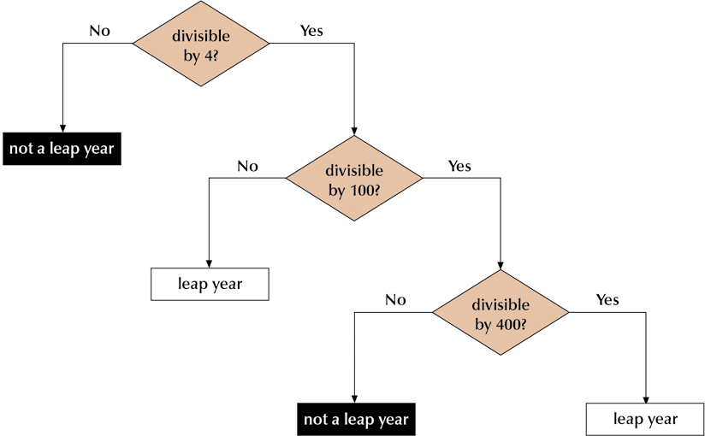
Calculating Leap Years
Tutorial 3
New Perspectives on JavaScript, Comprehensive

Slide 11
Working with Selection
On the next slide I’ve given you an algorithm in pseudocode for determining if a year is a leap year.
  Before you look, let’s see if we can write it ourselves on the board
Tutorial 3
New Perspectives on JavaScript, Comprehensive

Slide 12
Working with Selection
isLeapYear(assumes year)
  if year is divisible by 4 then
  if year is divisible by 100 then
  if year is divisible by 400 then
  leapYear = true
  else
  leapYear = false
  end if
  else
  leapYear = true
  end if
  Else
  leapYear = false
  End if
  Return leapYear
end
Tutorial 3
New Perspectives on JavaScript, Comprehensive

Slide 13
Working with Selection
Now let’s test the algorithm with the test years we identified
  Make a chart with the pseudocode on the left and the variables (year, leapYear) on the right
  Does the algorithm work for all 4 cases?
Now let’s change the algorithm to code
  Open a blank file and add the basic html tags for a page
  Create a script block in the head to contain the function definition
    How do you start the function? What’s year?
    How do you figure out if year is divisible by 4?
    What’s the general syntax for an if statement? See the next couple of slides.
    Be careful with the {} and indentation in the nested if statements.
  How would you test this function?
Questions?
Tutorial 3
New Perspectives on JavaScript, Comprehensive

Slide 14
The If Statement
Syntax
  if (condition) {
  commands
  }
Modulus operator
  Returns the integer remainder after dividing one integer by another
Tutorial 3
New Perspectives on JavaScript, Comprehensive

Slide 15
Nesting If Statements
General structure
  if (thisYear % 4 == 0) {
  if statement for century years
  }
Tutorial 3
New Perspectives on JavaScript, Comprehensive

Slide 16
The If...Else Statement
General structure
  if (condition) {
  commands if true
  } else {
  commands if false
  }
Tutorial 3
New Perspectives on JavaScript, Comprehensive

Slide 17
Using Multiple Else...If Statements
General structure
  if (condition 1) {
  first command block
  }
  else if (condition 2) {
  second command block
  }
  else if (condition 3) {
  third command block
  }
  ...
  else {
  default command block
  }
Tutorial 3
New Perspectives on JavaScript, Comprehensive

Slide 18
The Rest of the Tutorial
Now that we’re warmed up, we’ll start working on the rest of the tutorial.
I’ll start by showing you a model of the functions that are part of the solution called a structure chart.
  A structure chart is a design tool that illustrates the “pieces” of a solution and the data that’s shared between the pieces
  Visio is a tool that can be used to create a structure chart
Tutorial 3
New Perspectives on JavaScript, Comprehensive

Slide 19
Structure Chart
Each box represents a function
The box at the top is the "main" or calling function.
  The calendar function is the main function.
Each line represents a function call.
  Calendar calls writeCalTitle, writeDayNames, writeCalDays.
  writeCalDays calls daysInMonth.
Each arrow represents data involved in the function call – a parameter or a return value
  writeCalTitle has a parameter, calendarDay
  daysInMonth has a parameter, calendarDay and returns days
Tutorial 3
New Perspectives on JavaScript, Comprehensive

Slide 20
Days in Month
Assume that you’ve been asked to write a function called daysInMonth. It takes a date called calendarDay as it’s parameter and returns an integer representing the number of days in that month.
  Any questions about the problem?
  How many days does April have? May? How do you know?
  What about leap year?
  Based on what we know so far we might write an algorithm for the function like the one on the next slide
Tutorial 3
New Perspectives on JavaScript, Comprehensive

Slide 21
Days in Month
daysInMonth(assume calendarDay)
month = get month from calendarDay
year = get year from calendarDay
if month is September, April, June, November
days = 30
else if month is February
if year is a leapYear then
days = 29
else
days = 28
end if
else
days = 31
end if
return days
End
Tutorial 3
New Perspectives on JavaScript, Comprehensive

Slide 22
Days in Month
Unfortunately, the book doesn’t use an if statement to write the function. Instead it uses an array. Let me draw you a picture
The table below is an array. It’s a set of values that we want to treat in a parallel way.
  The set has a name, in this case, dayCount.
  Each individual value or element of the array can be accessed using the name of the array and a position or index. The first index is 0 (not 1)
dayCount
31 | 28 | 31 | 30 | 31 | 30 | 31 | 31 | 30 | 31 | 30 | 31
0
1
2
3
11
Tutorial 3
New Perspectives on JavaScript, Comprehensive

Slide 23
Days in Month
To determine the daysInMonth you
  Get the year from the calendarDay
  If the year is a leap year, change the element in the dayCount array for february (1) to 29 (rather than 28)
  Get the month from the calendar day
  Use the month as an index into the array dayCount and retrieve the corresponding element in the array and return that value
dayCount
31 | 28 | 31 | 30 | 31 | 30 | 31 | 31 | 30 | 31 | 30 | 31
0
1
2
3
11
Tutorial 3
New Perspectives on JavaScript, Comprehensive

Slide 24
Days in Month
Now let’s look at the code. Mine uses our isLeapYear function but it’s very similar to the code on page 838 in the text.
  Can you find the line in the code that creates the array?
  Can you find the line in the code that returns the appropriate element from the array?
Write the function definition in the script block in the head section of your TEST page.
  How will you test it?
Tutorial 3
New Perspectives on JavaScript, Comprehensive

Slide 25
WriteCalTitle
Now let’s look at the function writeCalTitle together. It’s the function that writes January 2010 at the top of the calendar. It’s on page 813 in the text
  Is there an array in the function? What is it called? What does it store? What’s in element monthName[0]?
  What does each line of code do? Pay particular attention to the line that uses the array. Which line is that? What does it do?
Add the function definition to your test page.
  How will you test it?
Tutorial 3
New Perspectives on JavaScript, Comprehensive

Slide 26
WriteDayNames
The function writeDayNames writes the day abbreviations across the top of the calendar.
  Assume that you have an array called dayName.
  Conceptually, how would you write all of the days in a table row using the array?
  The algorithm on the next slide does that. It uses the 3rd programming construct – repetition.
dayName[1]
Sun | Mon | Tue | Wed | Thu | Fri | Sat
Tutorial 3
New Perspectives on JavaScript, Comprehensive
dayName[0]
dayName[6]

Slide 27
WriteDayNames
writeDayNames(no parameters)
  Write an tr tag
  Index = 0
  While index <= 6
  write a td tag
  write the element in the array dayName at the current index
  write a closing td tag
  index ++
  End while
  Write closing tr tag
end
Sun | Mon | Tue | Wed | Thu | Fri | Sat
Tutorial 3
New Perspectives on JavaScript, Comprehensive

Slide 28
WriteDayNames
The loop is the section of the algorithm beginning with while and ending with end while.
  It contains a condition. As long as the condition is true the body of the loop executes
  When the last line in the loop body is executed, the loop condition is re-evaluated.
Tutorial 3
New Perspectives on JavaScript, Comprehensive

Slide 29
WriteDayNames
How would you test this?
  Create a chart with the pseudocode on the left and the variables (dayName and index) on the right. I'd also create a column for output.
  Step through each line, update the variables and produce the output as described in the algorithm.
What would happen if
  Omitted the index ++ line? Endless loop
  Changed the loop condition to < 6?
  Put the tr tags inside the loop?
Tutorial 3
New Perspectives on JavaScript, Comprehensive

Slide 30
WriteDayNames
pseudocode | index | dayName: Sun | Mon | Tue | Wed | Thu | Fri | Sat Output:
writeDayNames(no parameters) Write an tr tag Index = 0 While index <= 6 write a td tag write dayName[index] write a closing td tag index ++ End while Write closing tr tag end
Tutorial 3
New Perspectives on JavaScript, Comprehensive

Slide 31
WriteDayNames
A loop that starts with the keyword while is called a while loop.
The general syntax for creating a while loop in javascript is
  while (condition)
  {
  one or more statements that execute as long
  as the condition is true
  }
The next slide contains the function writeDayNames in JavaScript using a while loop.
Tutorial 3
New Perspectives on JavaScript, Comprehensive

Slide 32
WriteDayNames
function writeDayNames() {
var dayName = ["Sun", "Mon", "Tue", "Wed", "Thu", "Fri", "Sat"];
document.write("<tr>");
var index = 0;
while (index <= 6)
{
document.write("<td>");
document.write(dayName[index]);
document.write("</td>");
index ++;
}
document.write("</tr>");
}
Tutorial 3
New Perspectives on JavaScript, Comprehensive

Slide 33
WriteDayNames
The version of the function in the text uses another type of loop, the for loop. (code is on the next slide. p 828 in the text)
The general syntax for a for loop in JavaScript is
for (initialization; condition; update)
{
one or more statements that execute as long
  as the condition is true
  }
  The initialization section executes only once before the loop condition is evaluated for the first time.
  The condition is similar to the condition in the while loop. The loop repeats as long as the condition is true.
  The update section is executed after the body of the loop, just before the loop condition is evaluated
Tutorial 3
New Perspectives on JavaScript, Comprehensive

Slide 34
WriteDayNames
function writeDayNames() {
var dayName = ["Sun", "Mon", "Tue", "Wed", "Thu", "Fri", "Sat"];
document.write("<tr>");
for (var index= 0; index <= 6; index++)
{
document.write("<td>");
document.write(dayName[index]);
document.write("</td>");
}
document.write("</tr>");
}
Tutorial 3
New Perspectives on JavaScript, Comprehensive

Slide 35
WriteDayNames
function writeDayNames() {
var dayName = ["Sun", "Mon", "Tue", "Wed", "Thu", "Fri", "Sat"];
document.write("<tr>");
for (var i=0;i < dayName.length;i++)
{
document.write("<th class='calendar_weekdays'> "+dayName[i]+"</th>");
}
document.write("</tr>");
}
Tutorial 3
New Perspectives on JavaScript, Comprehensive

Slide 36
WriteDayNames
The actual code from the book is a little different
  It uses a variable i instead of index
  It uses the length property of the array instead of hard coding 6 in the loop condition.
  It uses a th tag and a style
  It combines all of the document.write statements into 1 line
Type the version that makes the most sense into the script block in the head section of your test page
  How will you test it?
  If you're using one of the versions in the slides, you'll want to change the td tags to th tags. You'll also want to add the style
Tutorial 3
New Perspectives on JavaScript, Comprehensive

Slide 37
The Do/While Loop
There's one more loop in JavaScript – the do while loop
  It begins with the keyword do at the top of the loop and ends with while followed by a condition at the bottom of the loop.
  Because the condition is at the bottom of the loop, the loop body is executed at least once
  Sometimes this type of loop is called an exit condition loop
Tutorial 3
New Perspectives on JavaScript, Comprehensive

Slide 38
The Do/While Loop
The general form of a do while loop in JavaScript is
  do
  {
  one or more statements that execute at least once and repeatedly as long as the condition is true
  }
  while (condition);
Tutorial 3
New Perspectives on JavaScript, Comprehensive

Slide 39
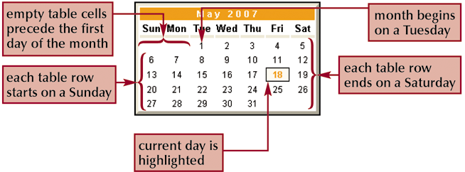
Building the Monthly Calendar
Month begins on Wednesday
Tutorial 3
New Perspectives on JavaScript, Comprehensive

Slide 40
WriteCalDays
The function that writes the days of the month is complicated. In general it
  Figures out what day of the week the first day of the month is
  Writes a tr tag
  Writes blank cells at the beginning of the month
  For each day in the month
    If the day is a Sunday, writes a tr tag to start a new row
    If the day = today, write the day in the correct style
    Write the day
    If the day is a Saturday, write the ending tr tag
    Increment the day
  Writes the closing tr tag
Tutorial 3
New Perspectives on JavaScript, Comprehensive

Slide 41
WriteCalDays
Let's look at the code on page 849 of the book together. Pay attention to
  How it uses date objects
  The loop that writes the blank cells
  The loop that writes all of the days
  The if statement that write the current day
  The if statements that start and end the row
Enter the function in your test page.
  How will you test it?
Tutorial 3
New Perspectives on JavaScript, Comprehensive

Slide 42
Calendar Function
This function calls all of the other functions
  The body of the function looks a lot like what we've done in your test page with one significant change
  It takes a string that represents the date for which you want to create the calendar at it's parameter
    If the parameter isn't provided, it creates a date object called calendarDay containing the current date and time
    Otherwise, it creates a date object from the string parameter that's provided
Tutorial 3
New Perspectives on JavaScript, Comprehensive

Slide 43
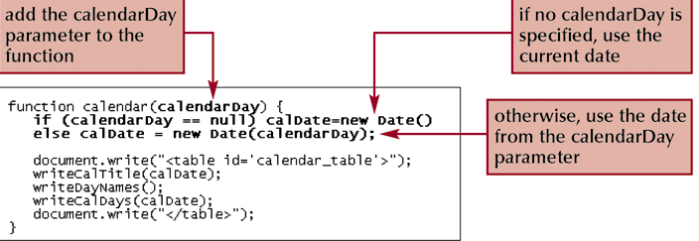
Calendar Function
Tutorial 3
New Perspectives on JavaScript, Comprehensive

Slide 44
Calendar Function
The code for this function is on page 850 and edited on 853 of the text.
  Let's look at together …
  Add it to your test page
  Test it without a parameter
  Test it with "February 9, 2014"
Now you're ready to add it all to the tutorial
  Add all of your functions to a script block in the top of the ccctxt.htm page or to the external javascript file caltxt.js
  Call the function in a script block in the div tag whose id is events in the body of the page.
    The text suggests that you call the function with a specific date. I don't care whether you call it with a parameter or without as long as you understand what the function will do in each case.
Tutorial 3
New Perspectives on JavaScript, Comprehensive

Slide 45
What’s Next
There are some things in the text that I didn't talk about
  Array methods. Good to know that you can sort and array using a method but it's not important to memorize the list.
  Switch statements. You should know this.
  Break and continue statements. Should be avoided. I can always write a more precise condition and eliminate them.
  Make sure you've read the book and are taking the reading quizzes.
Review – last part of lab 5
Tutorial 3
New Perspectives on JavaScript, Comprehensive

Slide 46
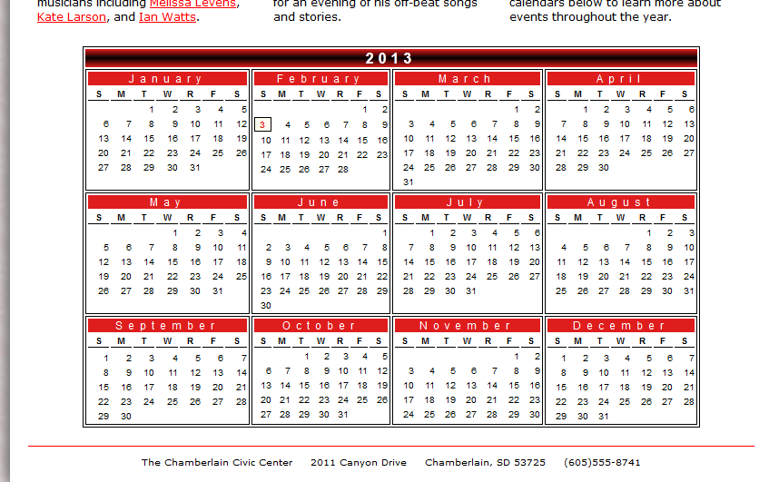
Review Notes
Tutorial 2
New Perspectives on JavaScript, Comprehensive

Slide 47
Review Notes
This problem asks you to
  Use functions provided by the text which create a monthly calendar. These functions are much like the functions you wrote in the tutorial.
  Call those functions repeatedly to create a yearly calendar with 3 rows of 4 months each
Tutorial 3
New Perspectives on JavaScript, Comprehensive

Slide 48
Review Notes
I've created a structure chart that illustrates the solution to the problem. Please note
  You have to change the function writeDayNames (provided by the text in the external js file) so that the days are S, M, T etc rather than Sun, Mon, Tue.
    Questions?
    This is 5
  You have to change the function writeMonthTitle (provided by the text in the external js file) so that the month name includes a link to the corresponding html file.
    Questions?
    This is 4
Tutorial 3
New Perspectives on JavaScript, Comprehensive

Slide 49
Review Notes
I've created a structure chart that illustrates the solution to the problem. Please note
  You have to write 2 additional functions.
    writeMonthCell – has 2 parameters, calendarDay and currentTime. Both are date objects. It writes a td tag with a calendar in it
      Writes an opening td tag.
      Calls the function writeMonth
      Writes a closing td tag
      Questions?
      This is part 2.
    yearly is a little more complicated
Tutorial 3
New Perspectives on JavaScript, Comprehensive

Slide 50
Review Notes
    yearly - has 1 parameter, calDate, which is a string representing the date to be highlighted on the calendar. It calls the function writeMonthCell 12 times to create the yearly calendar. This is part 3.
      A. should look familiar to you from the calendar function in the tutorial.
      B, C, D and E are pretty straight forward
      Questions about any of those parts?
Tutorial 3
New Perspectives on JavaScript, Comprehensive

Slide 51
Review Notes
    yearly (cont)
      F and G create the table with the 12 months in it. I'll show you my code. Make sure you can answer the following questions.
        Why are there 2 loops? What's the outer loop for? What's the inner loop for?
        Why is the table tag and the closing table tag outside the loops?
        Why is are the tr tags in the outer loop? Where are the td tags?
        What's the purpose of the variable monthNum? Where does it increment? Why does it start at -1?
        Why are the methods setDate and setMonth used in the inner loop?
This is part 2.
Tutorial 3
New Perspectives on JavaScript, Comprehensive

Slide 52
Review Notes
8 asks you to call the function yearly in the html file
Of course you’ll have to create a script element that accesses the external js file if you use one
You’ll also have to save and test and debug your code.
Tutorial 3
New Perspectives on JavaScript, Comprehensive

Slide 53
What’s Next
There are some things in the text that I didn't talk about
  Array methods. Good to know that you can sort and array using a method but it's not important to memorize the list.
  Switch statements. You should know this.
  Break and continue statements. Should be avoided. I can always write a more precise condition and eliminate them.
  Make sure you've read the book and are taking the reading quizzes.
Lab 6
  Case 1 and Case 2
Tutorial 13
Tutorial 3
New Perspectives on JavaScript, Comprehensive

